Slide 1
Difference between HTTP1.1 vs HTTP2
HTTP1.1
It works on the textual format.
There is head of line blocking that blocks all the requests behind it until it doesn’t get its all resources.
It uses requests resource Inlining for use getting multiple pages
It compresses data by itself.
HTTP/2
It works on the binary protocol.
It allows multiplexing so one TCP connection is required for multiple requests.
It uses PUSH frame by server that collects all multiple pages
It uses HPACK for data compression.

Slide 2
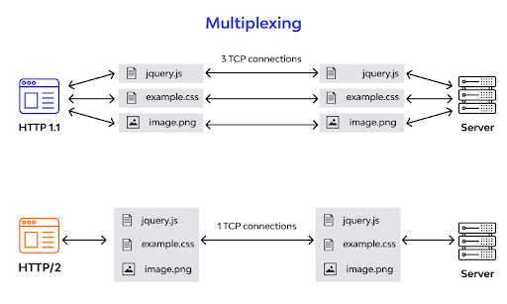

Slide 3
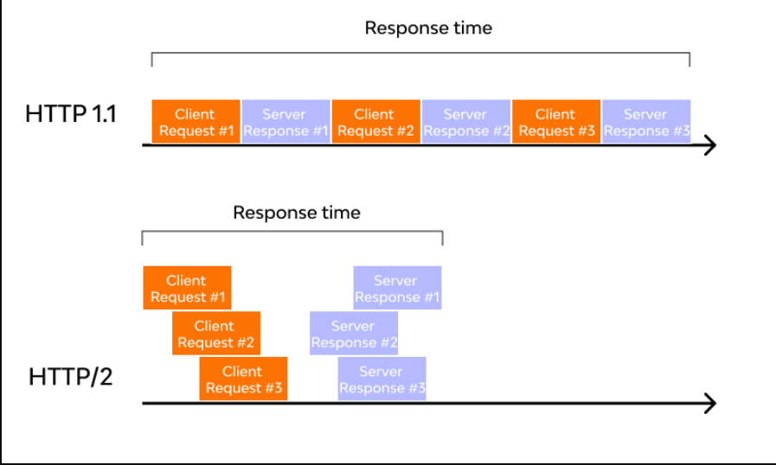
HTTP1.1 and HTTP/2
The client (browser) has to send a request to the server using the method (GET/POST).
Server responds with the requested resource, for example – image, alongside the status of what it did to the client’s request.
HTTP/1.1 addresses this problem by creating a persistent connection between server and client. Until explicitly closed, this connection will remain open. So, the client can use one TCP connection throughout the communication sans interrupting it again and again.
Considering the bottleneck in the previous scenario, the HTTP/2 developers introduced a binary framing layer. This layer partitions requests and responses in tiny data packets and encodes them. Due to this, multiple requests and responses become able to run parallelly with HTTP/2 and chances of HOL blocking are bleak.

Slide 4
Objects And Its Internal Representation In JavaScript
Objects in JavaScript
In JavaScript, objects are collections of key-value pairs, where keys are strings (or symbols) and values can be of any data type, including other objects. Objects are used to represent real-world entities, data structures, and more complex data types.
const person = { name: "Sreeram K", age: 22, email: "sreeramuidesigner@gmail.com" };
Internal Representation of Objects
Internally, JavaScript engines use various data structures to represent objects efficiently. One common approach is using a hash table or a similar structure to store the object’s properties and their corresponding values. This allows for fast access and manipulation of properties.
Internal Representation: { name: "Sreeram K", age: 22, email: "sreeramuidesigner@gmail.com" }

Slide 5
IP address
IP Address: An IP Address or Internet Protocol Address, is a unique number that identifies a device on the internet or a local network. IP Addresses are typically assigned by an internet service provider(ISP).
-> IP Address serves two main functions:
1. Network Interface Identification
2. Location Addressing
-> IP Addresses are generated using two main versions of internet protocol(IP) IPV4 and IPV6. IPV6 addresses are longer and can have trillions available. IPV4 addresses are only 32bits, while IPV6 addresses are made up to 128bits.
-> We can find IP Address in Windows by using the command prompt:
1. Search for “cmd” in the windows search
2. Click to get command line
-> IP Address serves two main functions:
1. Network Interface Identification
2. Location Addressing
-> IP Addresses are generated using two main versions of internet protocol(IP) IPV4 and IPV6. IPV6 addresses are longer and can have trillions available. IPV4 addresses are only 32bits, while IPV6 addresses are made up to 128bits.
-> We can find IP Address in Windows by using the command prompt:
1. Search for “cmd” in the windows search
2. Click to get command line

Slide 6
Port Number :
Port number is the part of the addressing information used to identify the senders and receivers of messages in computer networking. Different port numbers are used to determine what protocol incoming traffic should be directed to. Port number identifies a specific process to which an Internet or other network message is to be forwarded when it arrives at a server. Ports are identified for each protocol and It is considered as a communication endpoint.
They are divided into three categories
1. Well-Known Port Numbers
0 to 1023 are well-known port numbers are as they are used by well-known protocol services.
These are allocated to server services by the Internet Assigned Numbers Authority (IANA).
2. Registered Port Numbers
1024 to 49151 are registered port numbers i.e it can be registered to specific protocols by software corporations
3. Dynamic Port Numbers
49152 to 65535 are dynamic port numbers and they can be used by anyone

Slide 7
MAC Address /HTTP Method
Both MAC Address and IP Address are used to uniquely define a device on the internet. NIC Card’s Manufacturer provides the MAC Address, on the other hand, Internet Service Provider provides IP Address.
The main difference between MAC and IP address is that MAC Address is used to ensure the physical address of the computer. It uniquely identifies the devices on a network. While IP addresses are used to uniquely identifies the connection of the network with that device takes part in a network.
HTTP (Hypertext Transfer Protocol) is a fundamental protocol of the Internet, enabling the transfer of data between a client and a server. It is the foundation of data communication for the World Wide Web.
HTTP provides a standard between a web browser and a web server to establish communication. It is a set of rules for transferring data from one computer to another. Data such as text, images, and other multimedia files are shared on the World Wide Web. Whenever a web user opens their web browser, the user indirectly uses HTTP. It is an application protocol that is used for distributed, collaborative, hypermedia information systems.
Methods of HTTP
GET: Used to retrieve data from a specified resource. It should have no side effects and is commonly used for fetching web pages, images, etc.
POST: Used to submit data to be processed by a specified resource. It is suitable for form submissions, file uploads, and creating new resources.
PUT: Used to update or create a resource on the server. It replaces the entire resource with the data provided in the request body.
PATCH: Similar to PUT but used for partial modifications to a resource. It updates specific fields of a resource rather than replacing the entire resource.
DELETE: Used to remove a specified resource from the server.
HEAD: Similar to GET but retrieves only the response headers, useful for checking resource properties without transferring the full content.
OPTIONS: Used to retrieve the communication options available for a resource, including supported methods and headers.
TRACE: Used for debugging purposes to echo the received request back to the client, though it’s rarely used due to security concerns.
CONNECT: Used to establish a tunnel to the server through an HTTP proxy, commonly used for SSL/TLS connections.

